Slide 1
Fundamentals of Tuberculosis (TB)
James Gaensbauer, MD, MScPH
Associate Professor of Pediatric and Adolescent Medicine
Medical Director of Education and Training, Mayo Clinic Center for Tuberculosis
Notes:
Give some background here. Historical, number 1 cause of ID death globally.

Slide 2
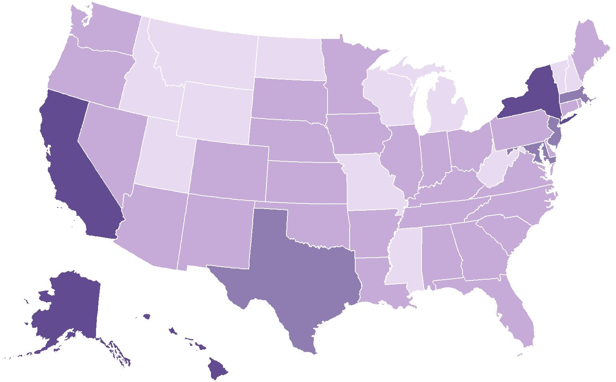
TB Incidence Rates* by Reporting Area, United States, 2023
Massachusetts
3.2
New York
4.6†
New Jersey
3.7
California
5.4
Maryland
3.3
District of Columbia
4.0
Hawaii
8.1
Alaska
10.5
Incidence Rate
Texas
4.1
<1.5
1.5–<2.9
*Cases per 100,000 persons
†Includes New York City
2.9–<4.5
≥4.5
Centers for Disease Control and Prevention. (2024, July 17). Tuberculosis (TB) disease in the United States, 1993–2023 [Slide set]. Division of Tuberculosis Elimination, National Center for HIV, Viral Hepatitis, STD, and TB Prevention, U.S. Department of Health and Human Services. https://www.cdc.gov/tb-surveillance-report-2023/media/pdfs/2024/10/2023_TB_in_the_United_States_Slide_Set.pdf
Notes:
Kansas: 2.2/100,000 46 cases in 2023. Breaking that record now!

Slide 3
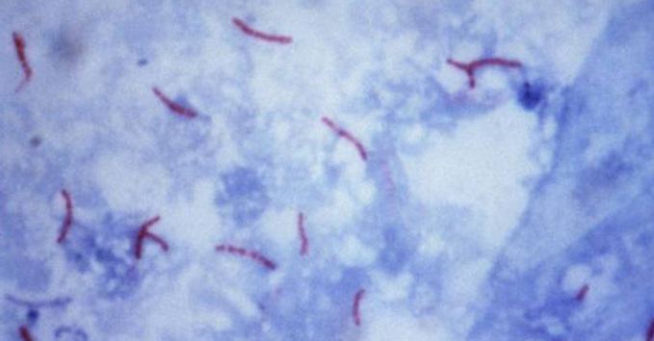
Mycobacterium Tuberculosis
What is it?
Can be identified under a regular light microscope.
Most mycobacterium retain stains even after washes and therefore are called “acid-fast” bacilli or AFB
https://www.cdc.gov/tb/hcp/education/self-study-modules-on-tuberculosis.html

Slide 4
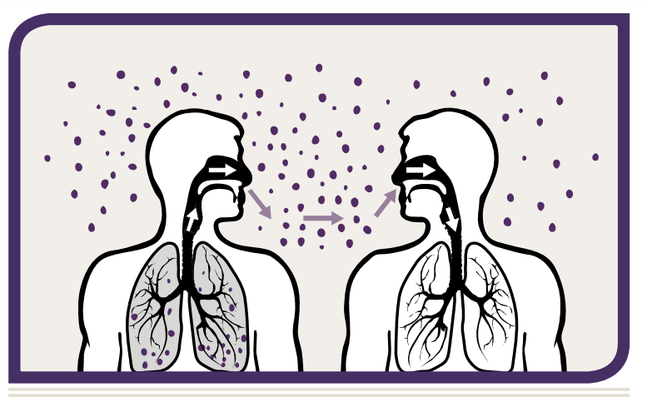
Pathogenesis of TB
Adapted from: www.cdc.gov/tb/media/pdfs/Self_Study_Module_1_Transmission_and_Pathogenesis_of_Tuberculosis.pdf

Slide 5
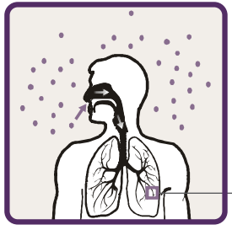
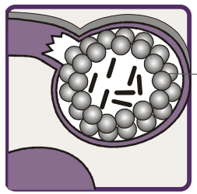
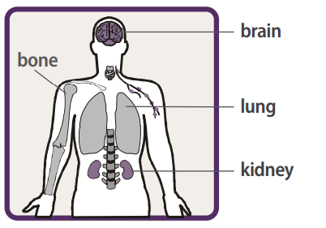
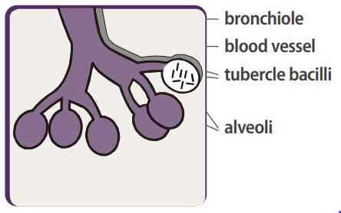
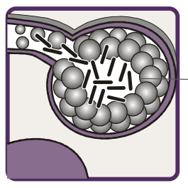
Pathogenesis of TB
Adapted from: www.cdc.gov/tb/media/pdfs/Self_Study_Module_1_Transmission_and_Pathogenesis_of_Tuberculosis.pdf

Slide 6
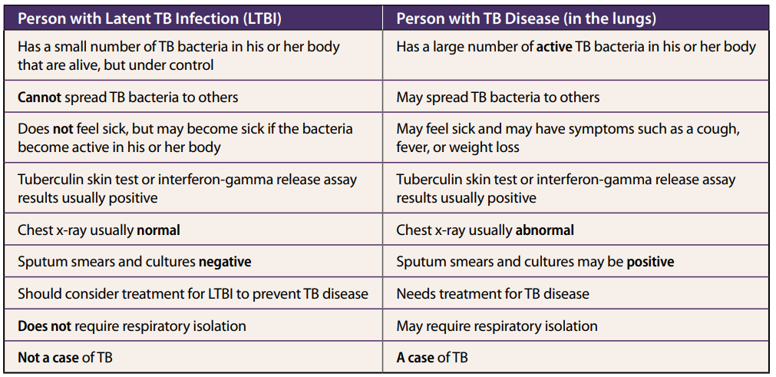
Adapted from: www.cdc.gov/tb/media/pdfs/Self_Study_Module_1_Transmission_and_Pathogenesis_of_Tuberculosis.pdf

Slide 7


When Should We Suspect TB?
Symptoms | Person

Slide 8
Symptoms of TB
Non-specific Constitutional Symptoms
Respiratory Symptoms
Symptoms of Possible Extra-pulmonary TB
Loss of appetite
Unexplained weight loss
Night sweats,
Fever
Fatigue
Prolonged cough (3 weeks or longer)
Shortness of breath
Hemoptysis
Chest pain
Blood in the urine (TB of the kidney)
Headache/confusion (TB meningitis)
Back pain (TB of the spine)
Hoarseness (TB of the larynx)

Slide 9
Persons at Risk for Developing TB Disease
Those who have an increased likelihood of exposure to persons with TB disease
1
Those with clinical conditions that increase their risk of progressing from LTBI to TB disease
2

Slide 10
Increased Likelihood of Exposure to Persons with TB Disease
Close contacts to person with infectious TB
Recent immigrants from TB-endemic regions of the world
Residents and employees of high-risk congregate settings (e.g., correctional facilities, homeless shelters, health care facilities)

Slide 11
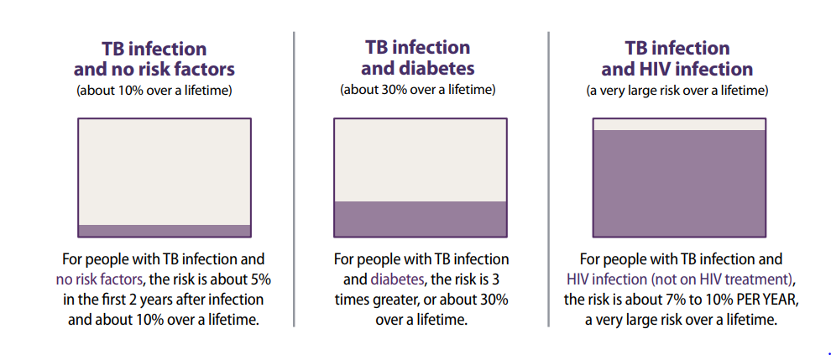
Persons at Risk for Developing TB Disease
Adapted from: www.cdc.gov/tb/media/pdfs/Self_Study_Module_1_Transmission_and_Pathogenesis_of_Tuberculosis.pdf

Slide 12
Tuberculosis Tests
TB suspect based
on clinical findings
LTBI suspect based on epidemiologic risk or contact with active case
(no clinical findings)
X-ray
(Test for infection (TST/IGRA))
Test for infection (TST/IGRA)
X-ray
Consider window period/need for repeat testing
Additional evaluation as needed
Microbiologic Testing
LTBI treatment
No further evaluation

Slide 13
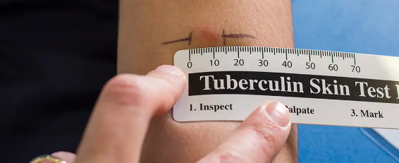
Tuberculin Skin Test (TST)

Slide 14
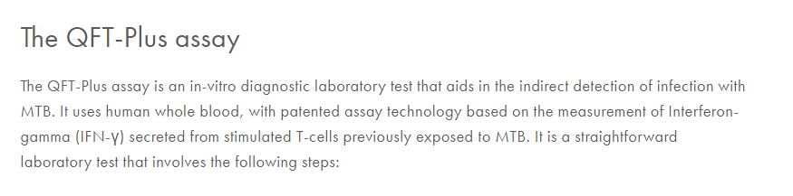
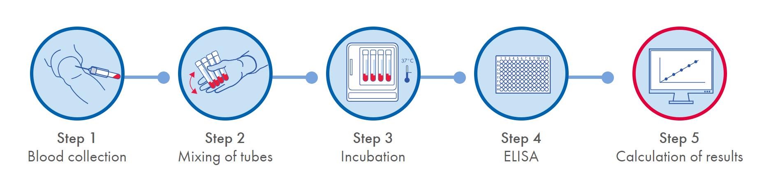
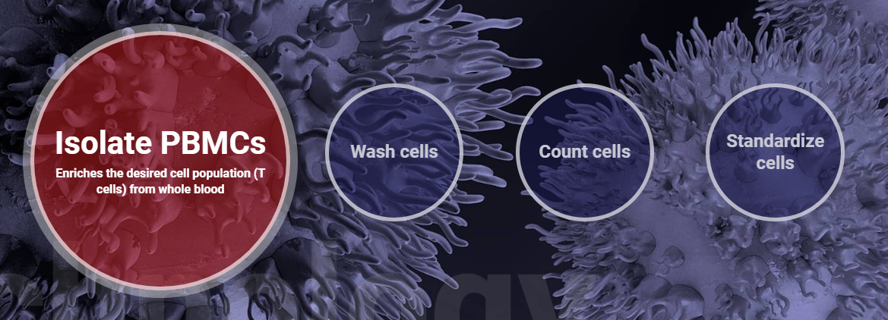

Interferon-Gamma Release Assays (IGRA)

Slide 15
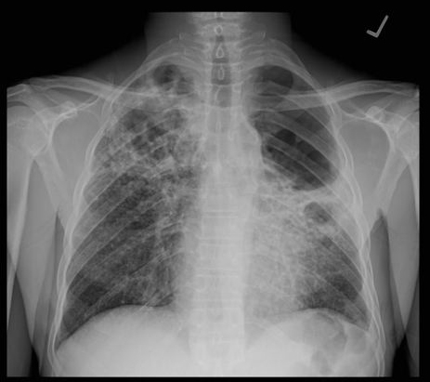
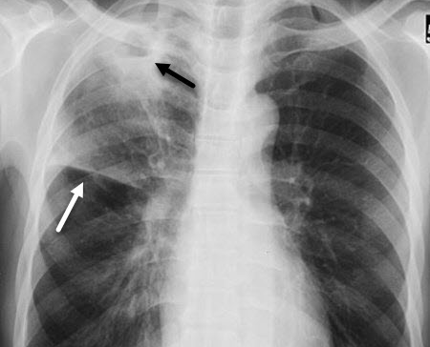
TB Radiology
Notes:
Tuberculosis, cavitary. There is a cavity in the right upper lobe with an air-fluid level (black arrow). There is volume loss in the right upper lobe as evidenced by elevation of the minor fissure (white arrow).

Slide 16
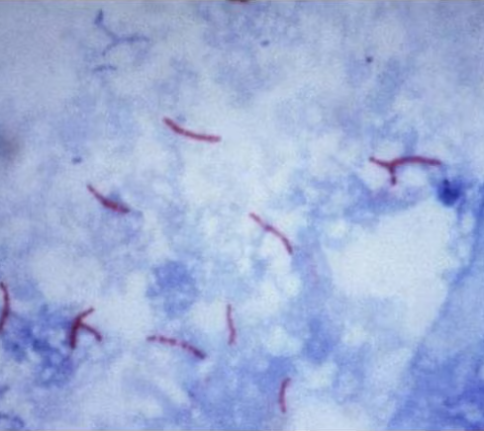
AFB Smear
This Photo by Unknown Author is licensed under CC BY-SA
Notes:
70% when three samples are used, so 1/3 may be negative. Also false positive. Semi-quantitative. CORRELATE with infectiousness

Slide 17
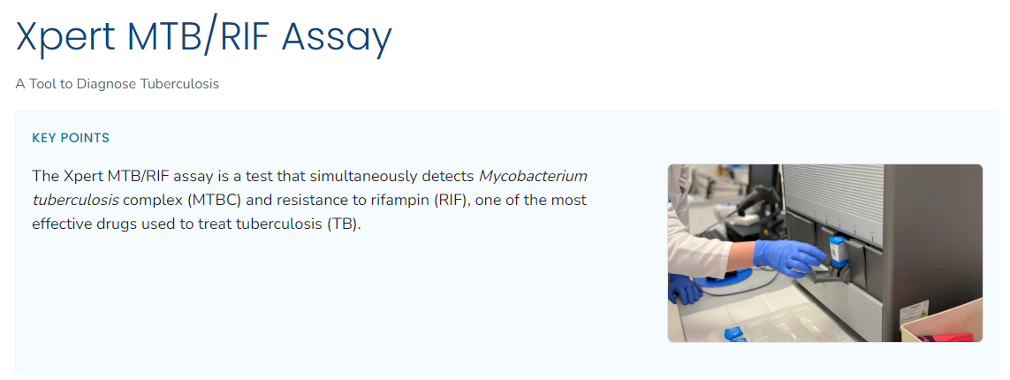
https://www.cdc.gov/tb/php/laboratory-information/xpert-mtb-rif-assay.html

Slide 18
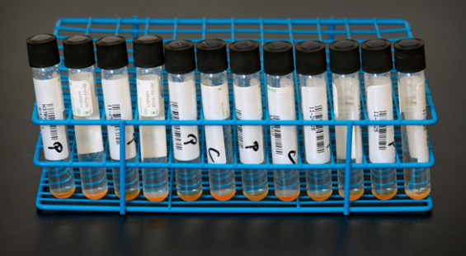
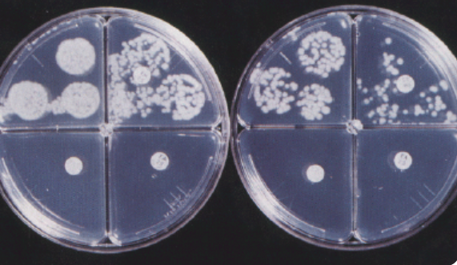
Mycobacterial Culture
Mycobacteria Growth Indicator Tube (MGIT)
Solid Media
https://www.cdc.gov/tb/hcp/education/self-study-modules-on-tuberculosis.html
Notes:
Provides confirmation of MTB and standard susceptibility (RIPE)

Slide 19
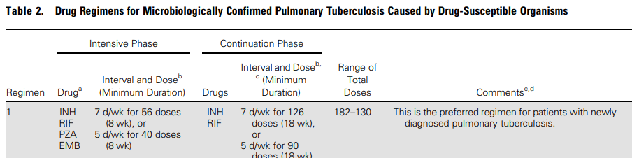
Treatment of TB Disease: “RIPE”
Nahid, P., Dorman, S. E., Alipanah, N., Barry, P. M., Brozek, J. L., Cattamanchi, A., ... & Daley, C. L. (2016). Official American Thoracic Society/Centers for Disease Control and Prevention/Infectious Diseases Society of America Clinical Practice Guidelines: Treatment of Drug-Susceptible Tuberculosis. Clinical Infectious Diseases, 63(7), e147–e195. https://doi.org/10.1093/cid/ciw376

Slide 20



Treatment of Latent TB Infection (LTBI)

Slide 21
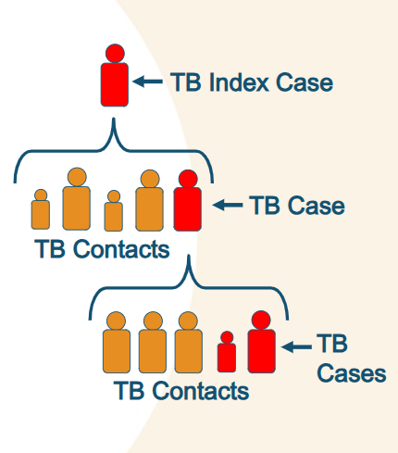
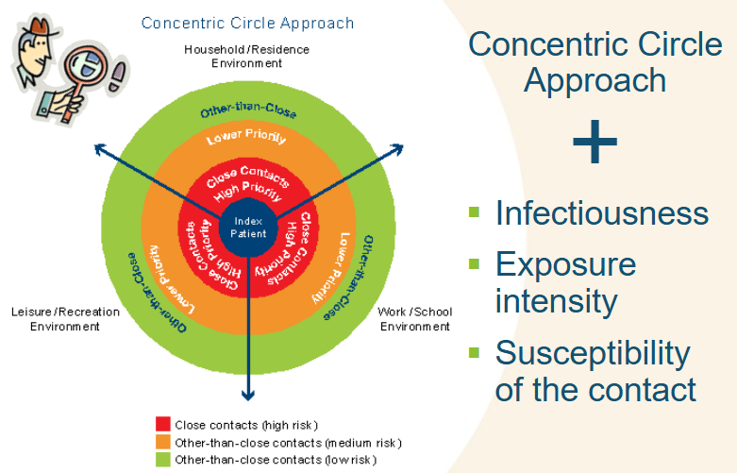
Public Health Response to a TB Case: Contact Investigation
Caribbean TB Guidelines, 2010
Notes:
Among patients with active TB

Slide 22
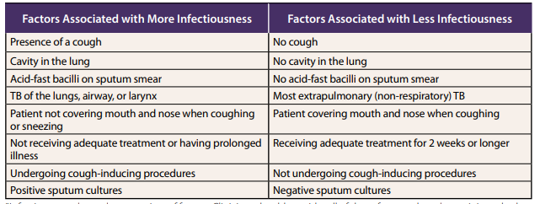
Contagiousness and Infection Control
Notes:
Among patients with active TB

Slide 23
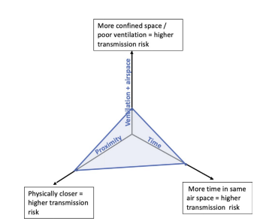
Contagiousness and Infection Control
Rea E. et. al, Canadian Journal of Respiratory, Critical Care, and Sleep Medicine, 2022
Notes:
Compare a household to a health care setting

Slide 24
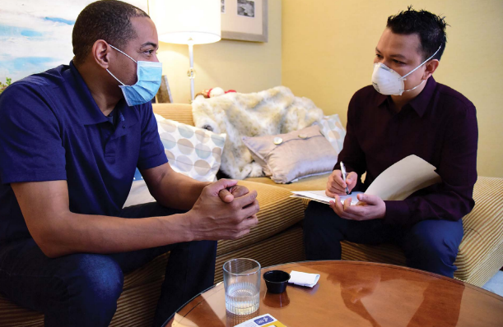
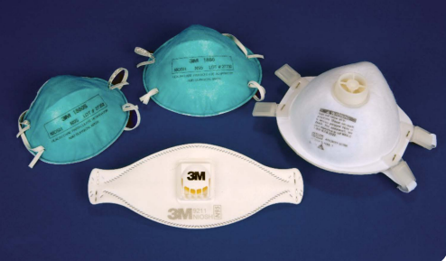
Infection Prevention in Health Care Setting
Source: CDC
Notes:
Also note infrastructure—airflow, outside, etc.

Slide 25
Patients Who are Not Contagious
Children before puberty
Latent tuberculosis
Patients established on effective treatment
Notes:
Comment on stigma
Also make point about confidence for HCWs and all staff to work with TB patients and not be axious.

Slide 26

Thank you!

